Slide 1
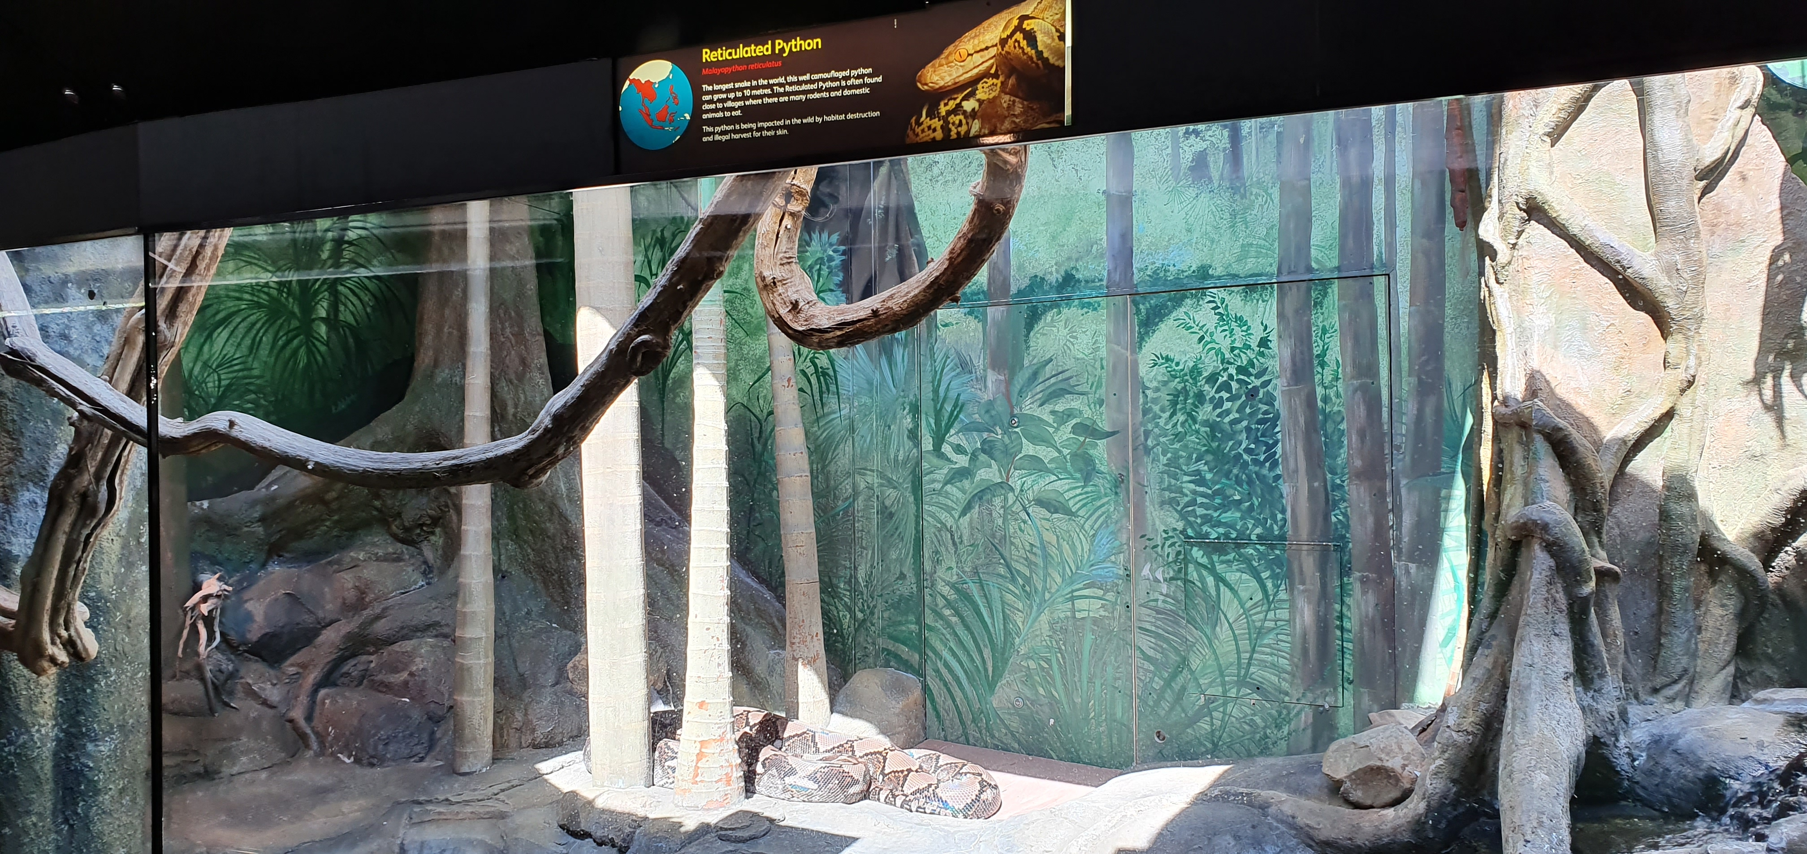
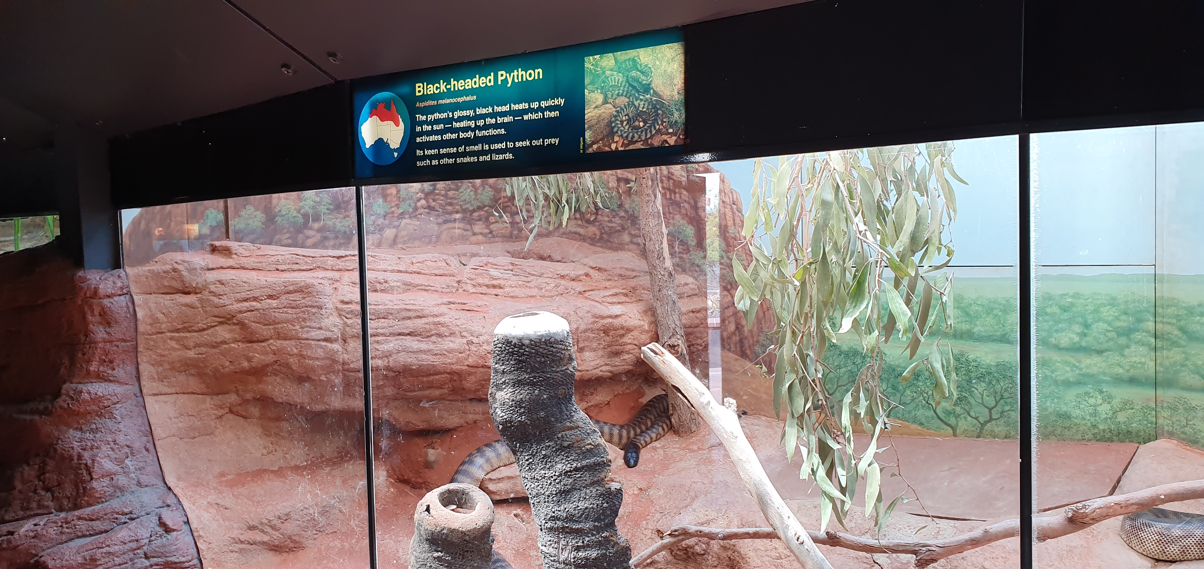
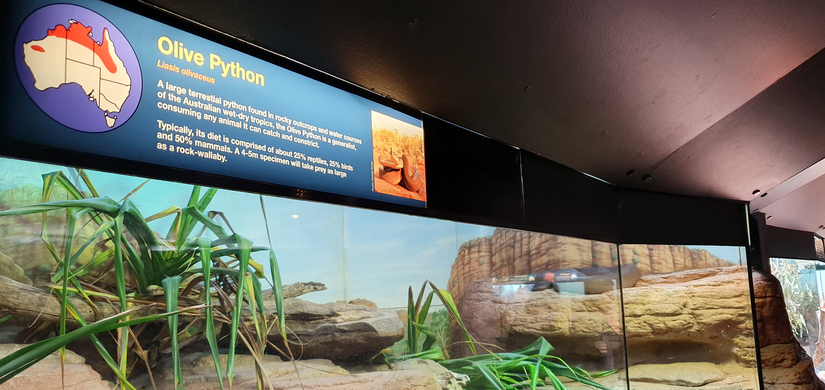
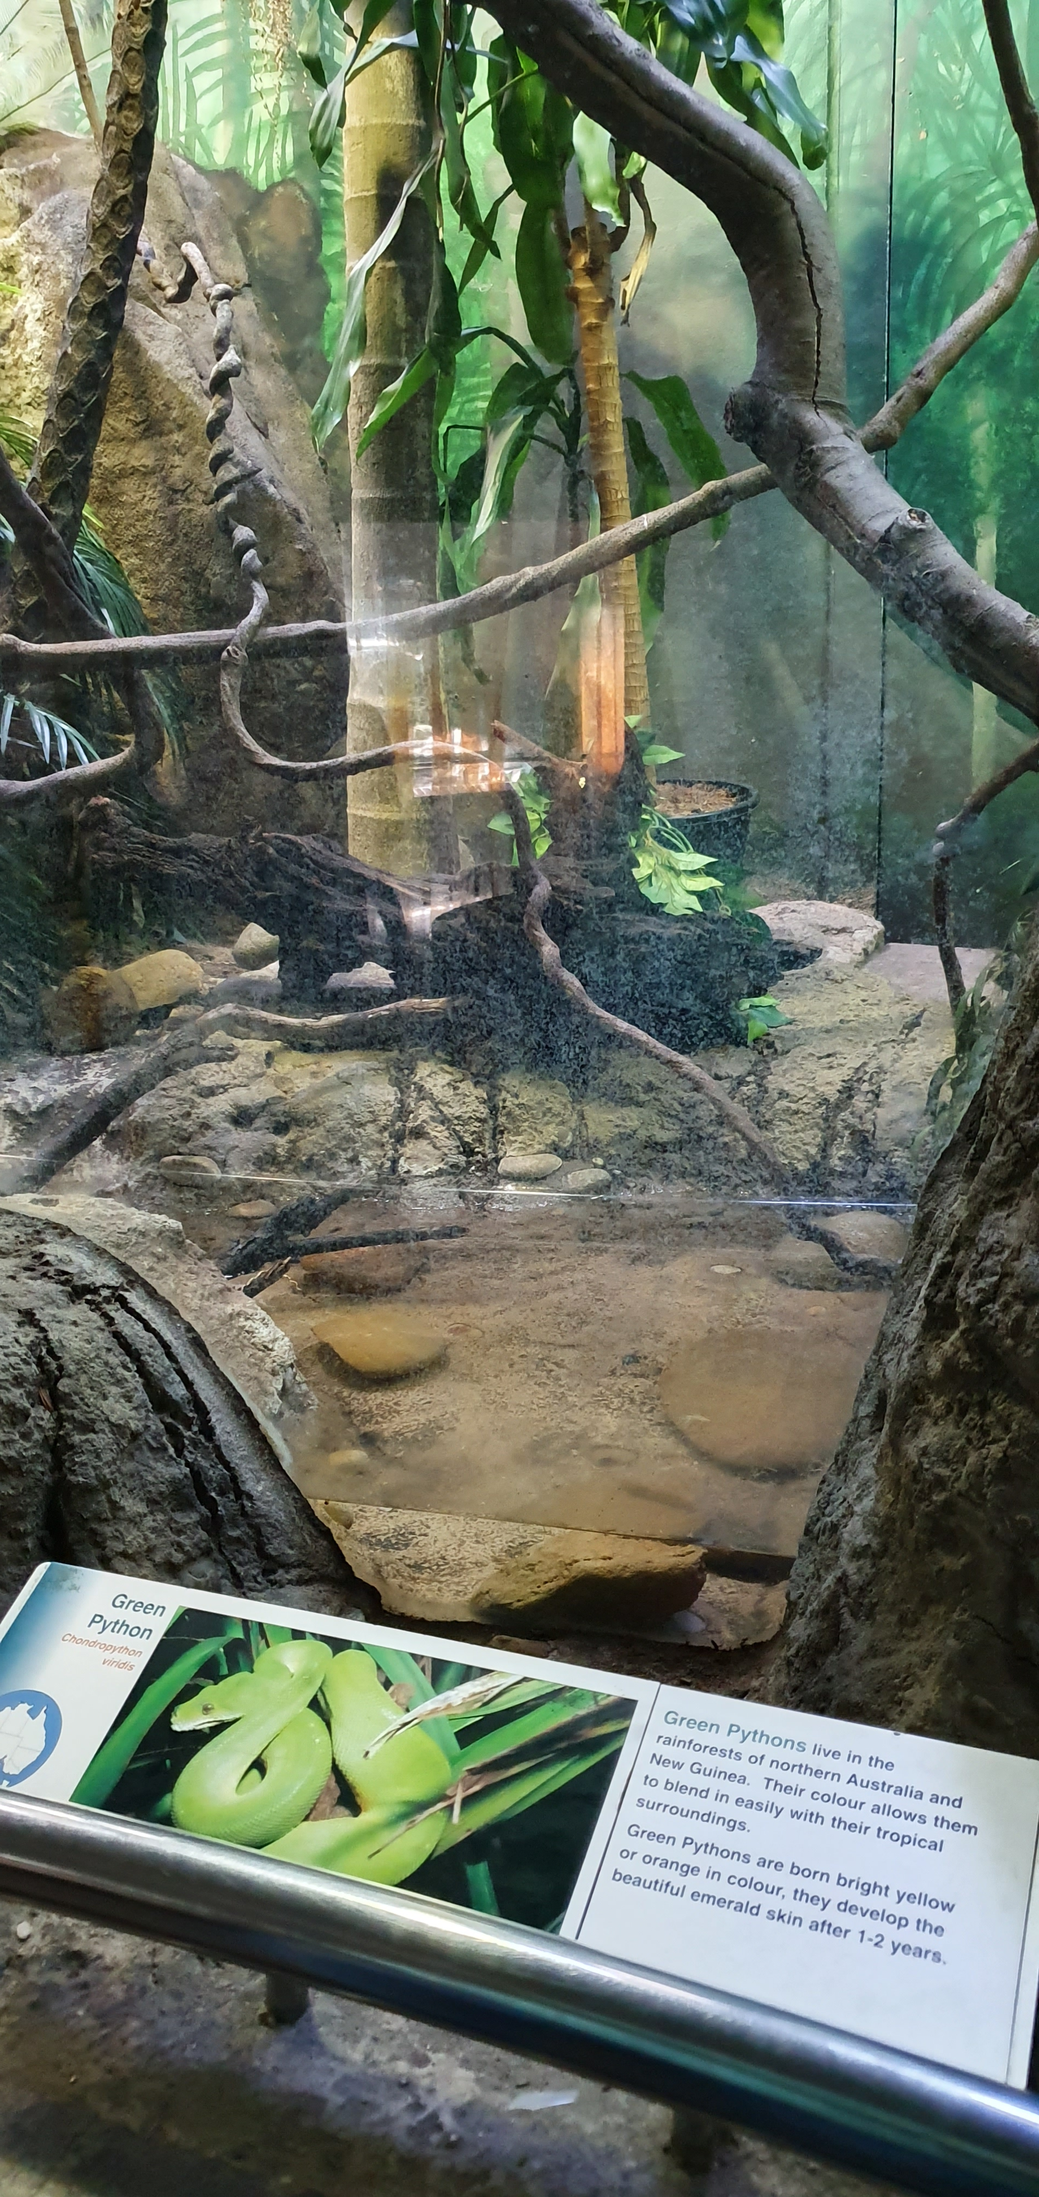
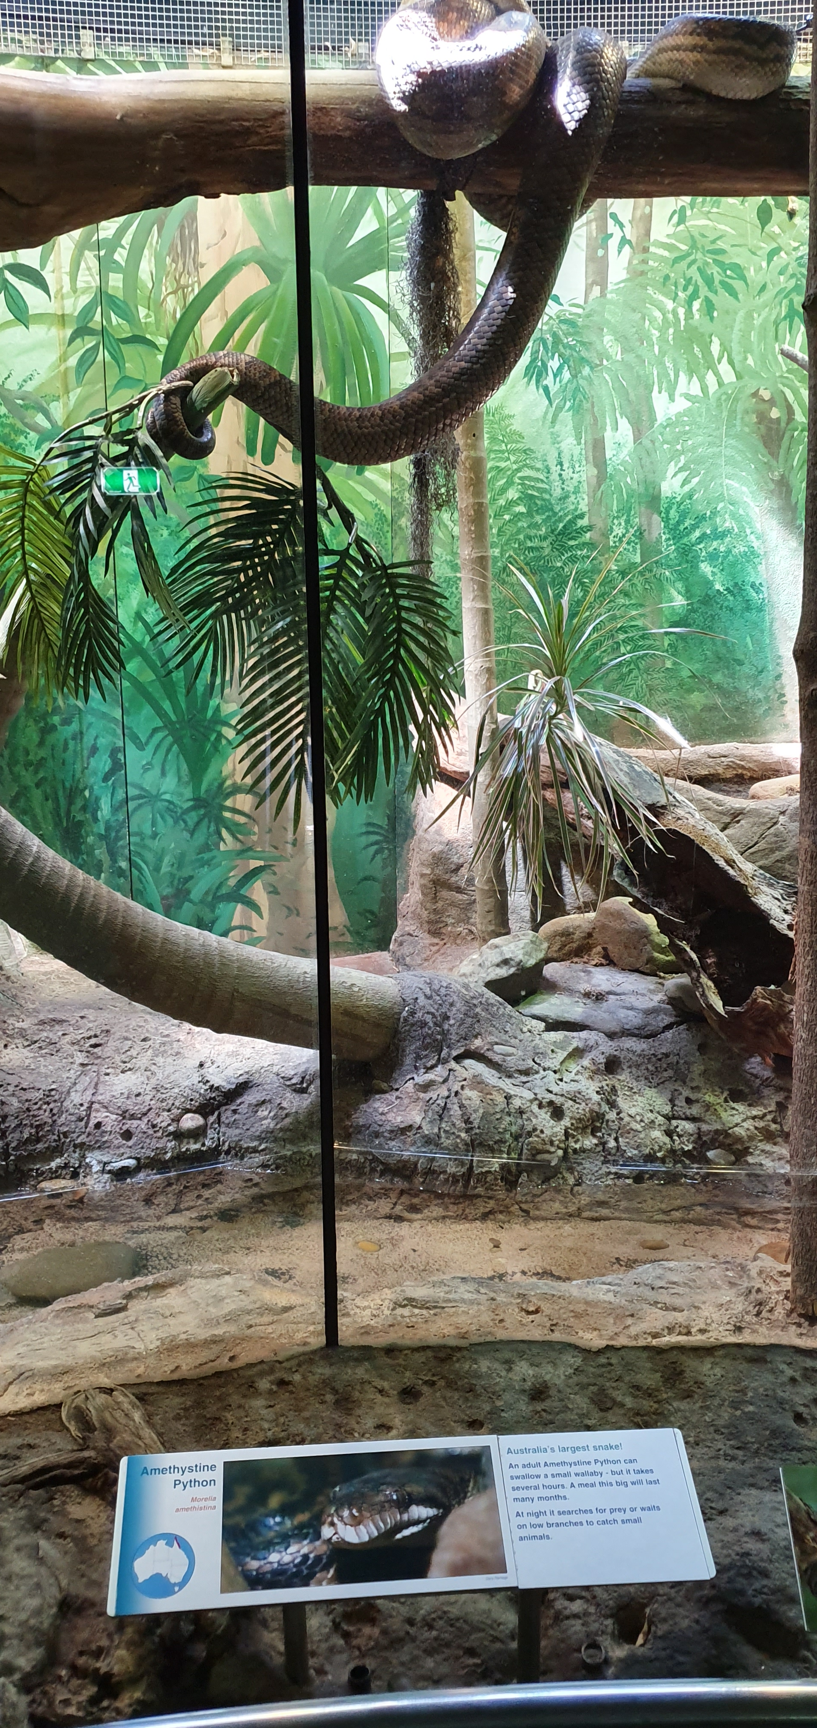
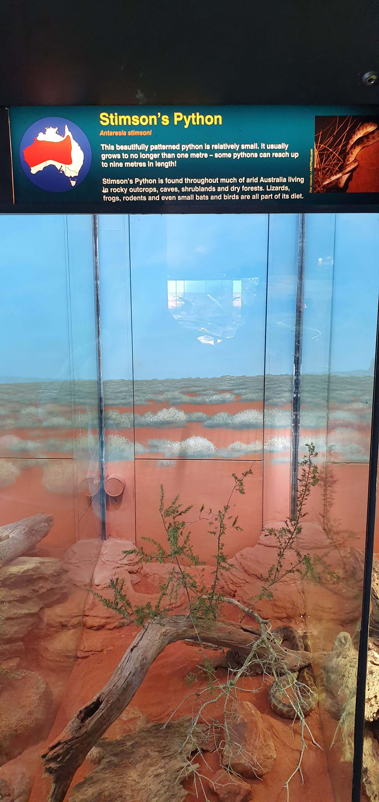
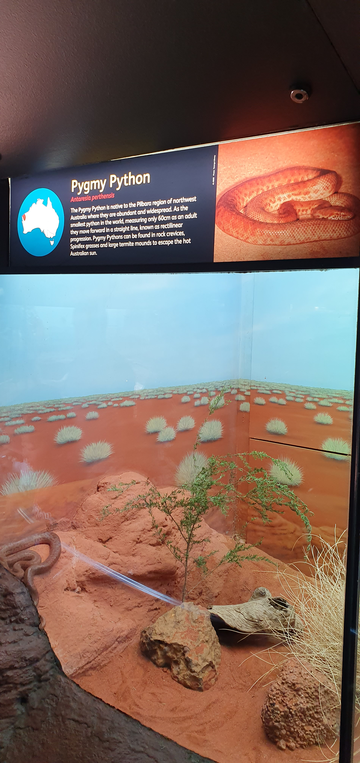
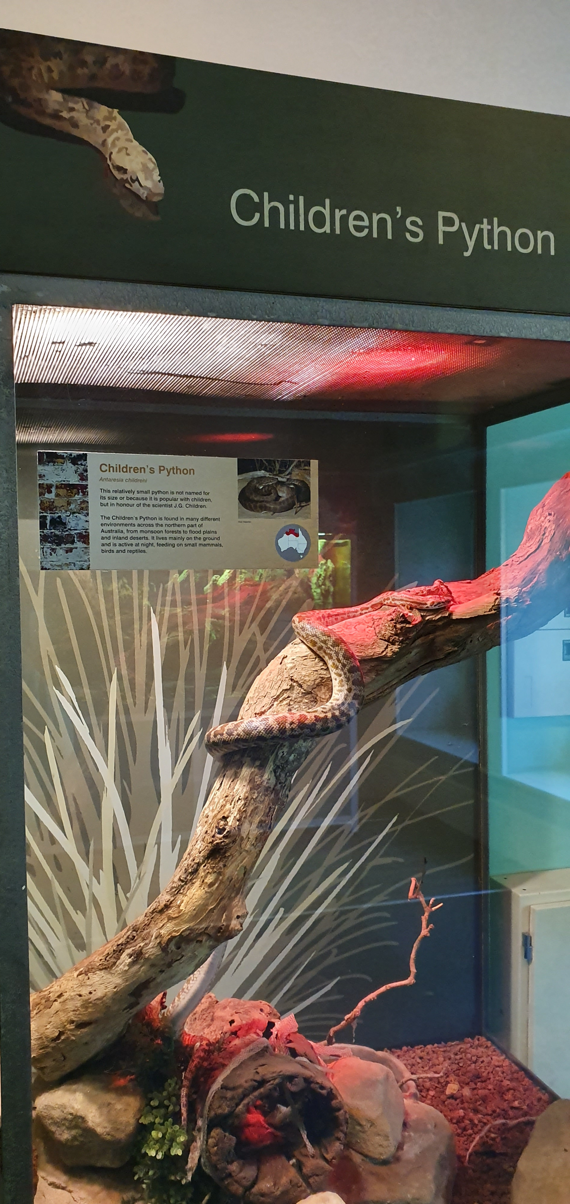
PYTHON 101: DEFINING THE ZOO

Slide 2

What is Python?
Widely used high-level, interpreted, dynamic programming language.
Emphasizes code readability.
Syntax focused on expressing things in fewer lines.
Similar to R and Matlab.

Slide 3
Why Python?
https://www.datacamp.com/community/blog/why-your-company-needs-python-for-business-analytics

Slide 4
Improves Work for Everyone
Widely used programming language.
Huge growing ecosystem due to its open source nature.
Almost every industry/academia on board.

Slide 5
Is Replacing Excel
Excel isn’t scalable.
Excel is prone to errors.
Date shift.
Allows collaboration.

Slide 6
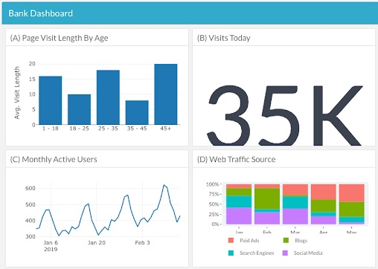
Descriptive Analytics and Dashboards
Exploratory data analysis.
Data manipulation.
Streamline work flows.
Creating visualisations.

Slide 7
Machine Learning/Computer Vision
Predicting and classifying new data.
Recommender systems.
Can import popular Google machine learning libraries:
Tensorflow
Tesseract (Optical character recognition)

Slide 8
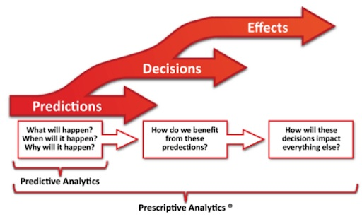
Predictive/Prescriptive Analytics
Decision science:
Anticipate what, when and why certain things happen.
What to do with the information?
Deep learning to optimise such outcomes!

Slide 9
Some statistics

Slide 10
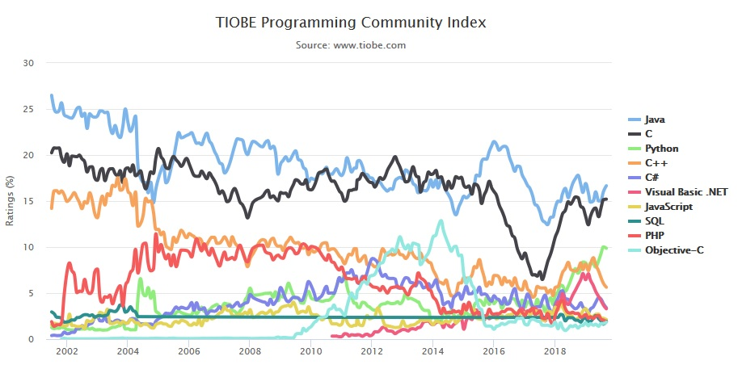
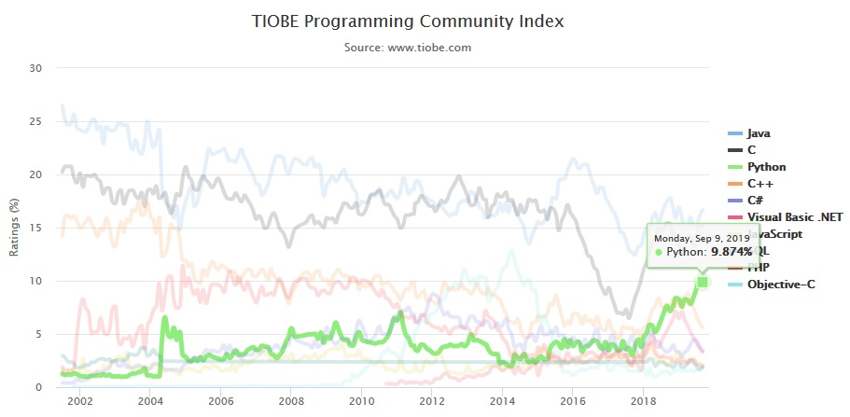
Python is the third most popular programming language according to the TIOBE index, being the fastest growing one in this rubric for the current year.

Slide 11
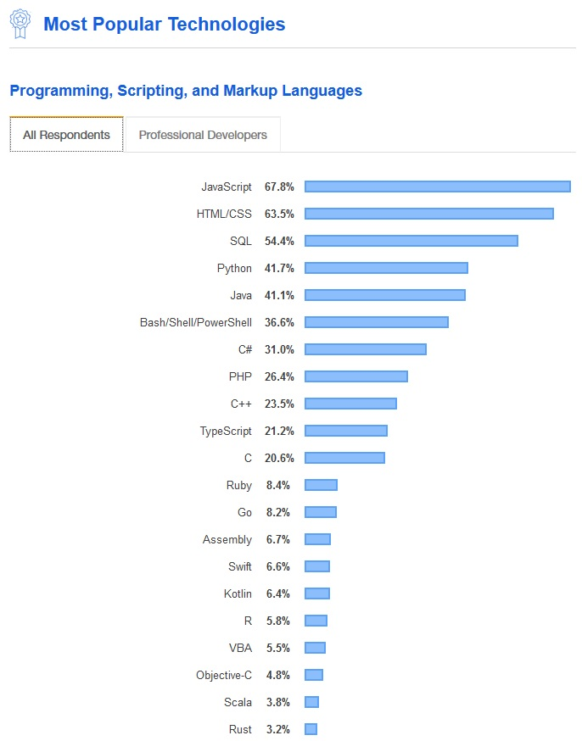
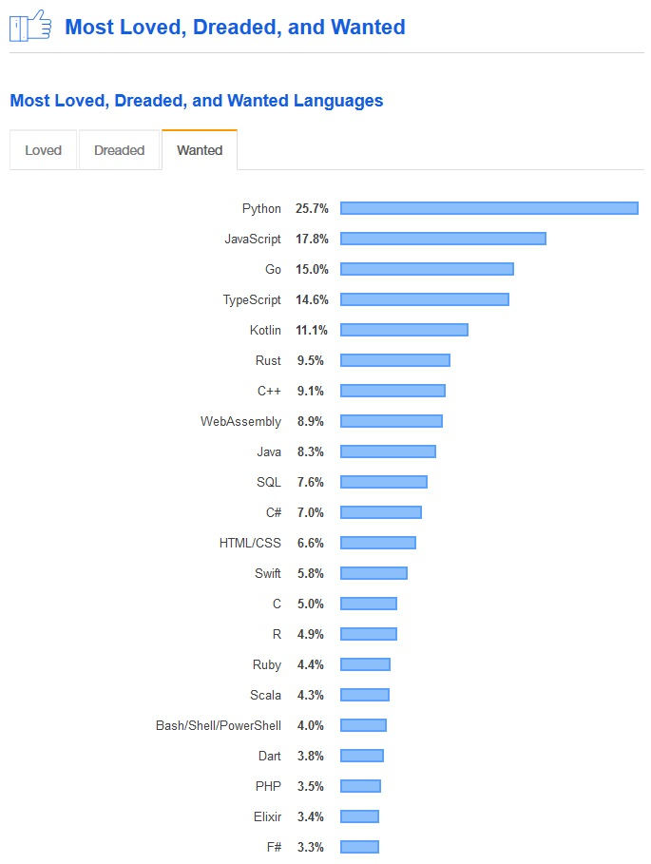
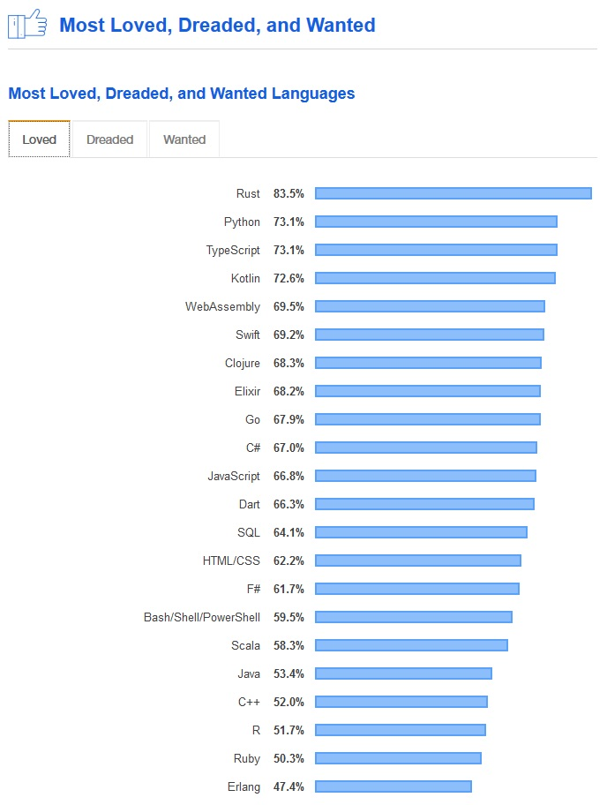
According to the 2019 developer survey run by Stack overflow, Python is the 4th most popular programming language in the world, both for general public and for professional developers.

Slide 12
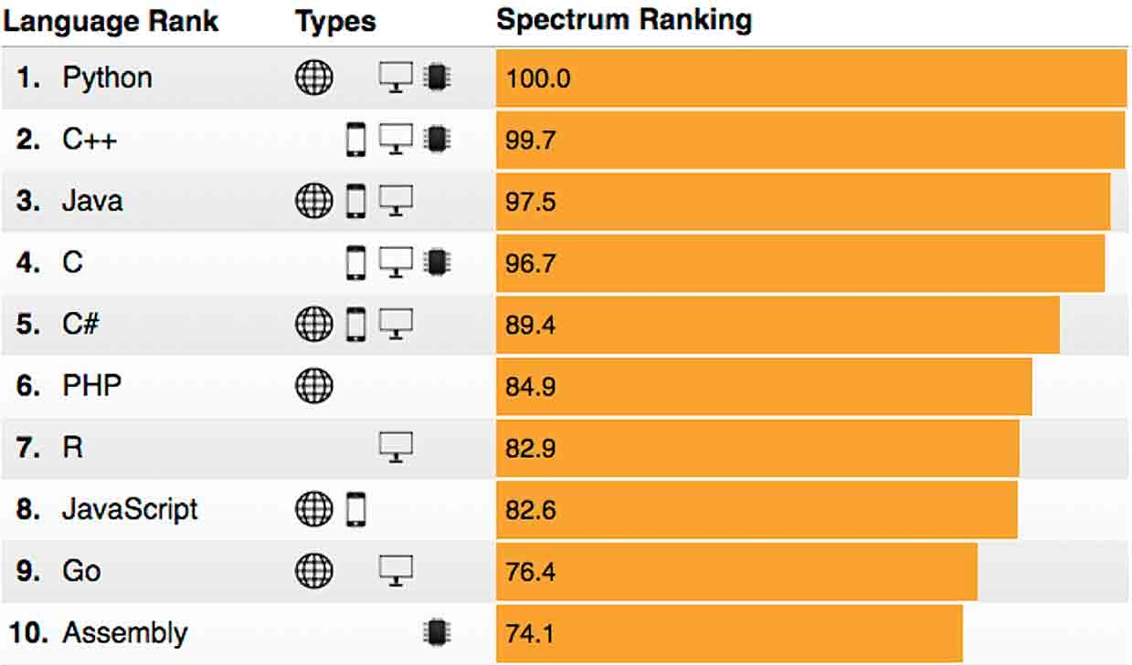
Python is currently the best ranked programming language according to the Institute of Electrical and Electronics Engineers (IEEE).

Slide 13
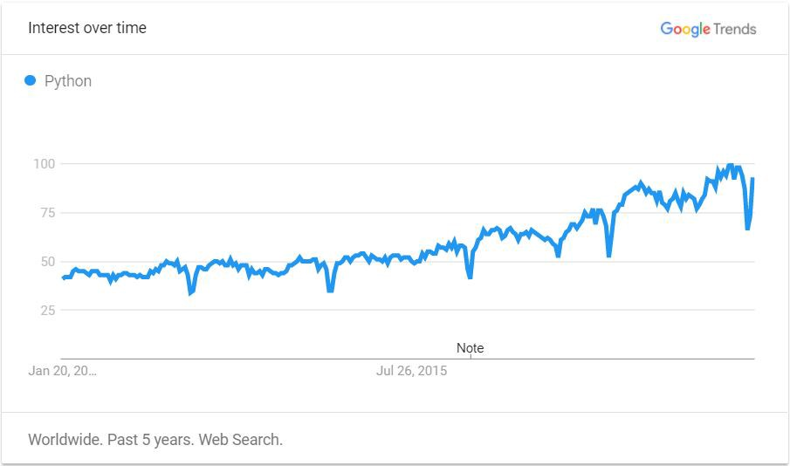
Python is currently the language with the fastest growing rate of interest by employers according to Google Trends.

Slide 14
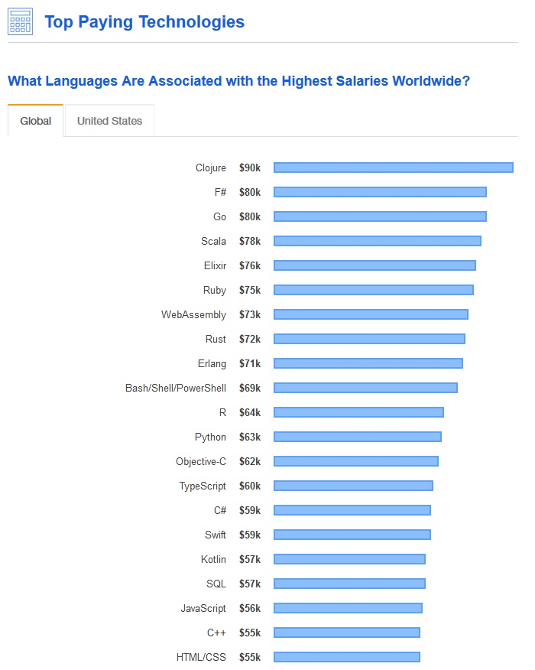
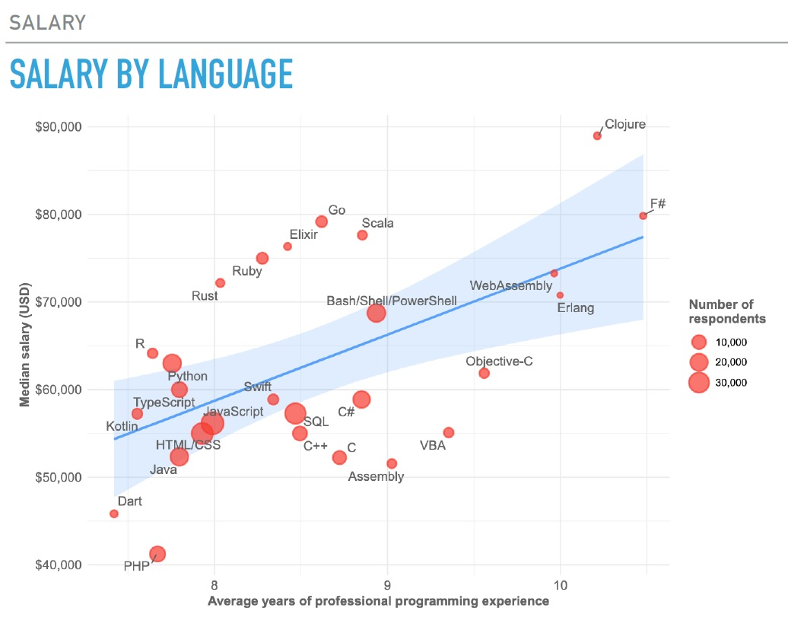
It is the 12th best paid language, but one of the fastest to adopt.

Slide 15
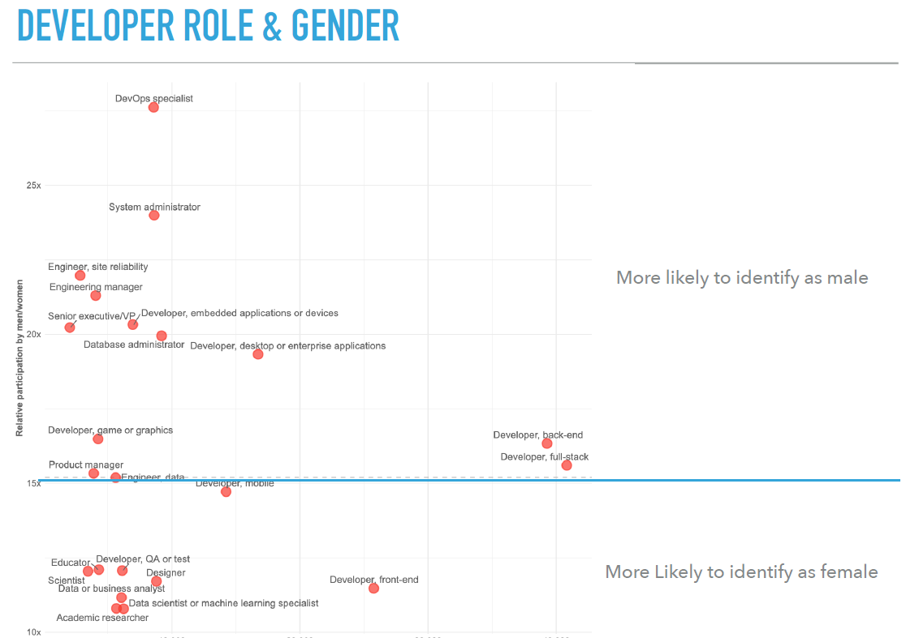
It promotes gender equality! (in a way…)

Slide 16
How does it look like?
Let’s open the terminal/prompt

Slide 17
Python 2 or 3?
UNIX-based OS (MacOS, Ubuntu, etc…) sometimes come with a pre-loaded version of Python 2.
Co-existed for >10 years, but Python 2 Will be discontinued from Jan 2020.
Most packages not supported by Python 2
make sure Python 3 is the main one in your PC.

Slide 18

Package management
'Batteries Included programming language’.
PyPI (Python Package Index) has 178,000+ downloadable packages.
What about library dependencies?
Package X
Package A v3
Package B v1.7
Package Y
Package B v.2.1
Package C v1.8
Notes:
-Python has been described as the 'Batteries Included programming language' but beyond the core packages provided on installation, it is enormously extensible. PyPI (the most common way to install additional libraries) has over 178,000 downloadable packages.
-But many packages have chains of dependencies. High-level package X might need packages a, b, and c. And high-level package Y might need packages b,c, d and e.
-What happens if X needs package b version 2.1 and Y needs b versions 1.7? We get into a dependency hell!

Slide 19
IDEs and Text Editors
IDE (Integrated Development Environment): Program dedicated to SW Development.
IDEs may support different languages, others are Python-bound.
Requirements:
Save and reload code
Run code within the environment (run code within)
Debugging Support
Syntax highlight
Automatic formatting (indents)
https://realpython.com/python-ides-code-editors-guide/

Slide 20
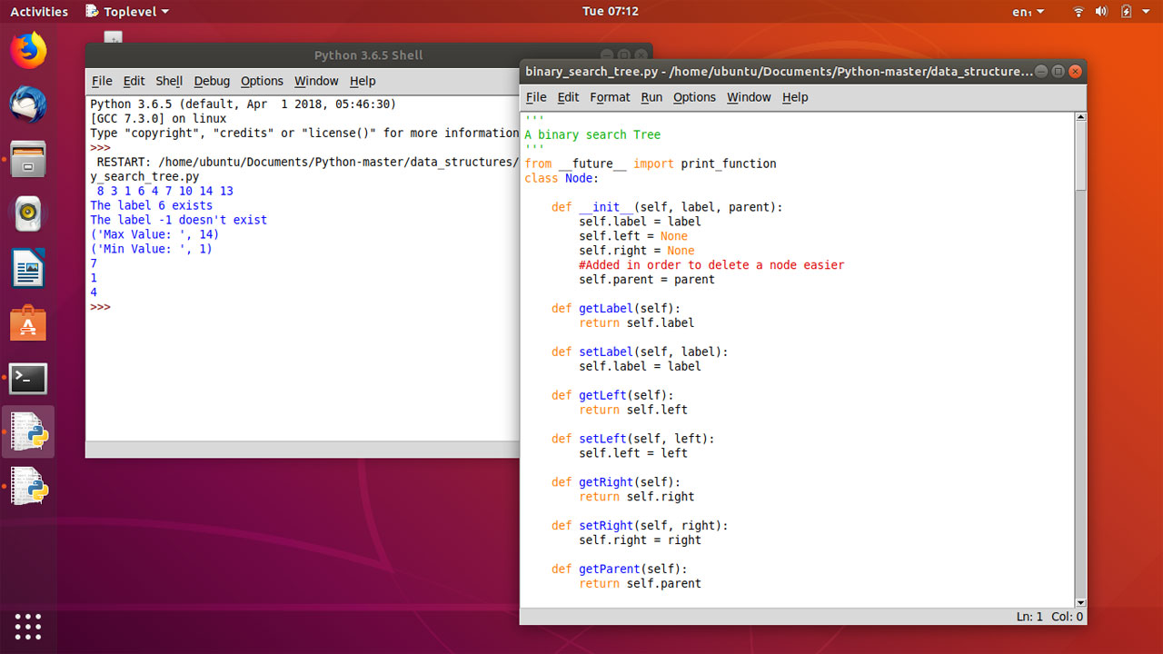
Python Shell/IDLE

Slide 21
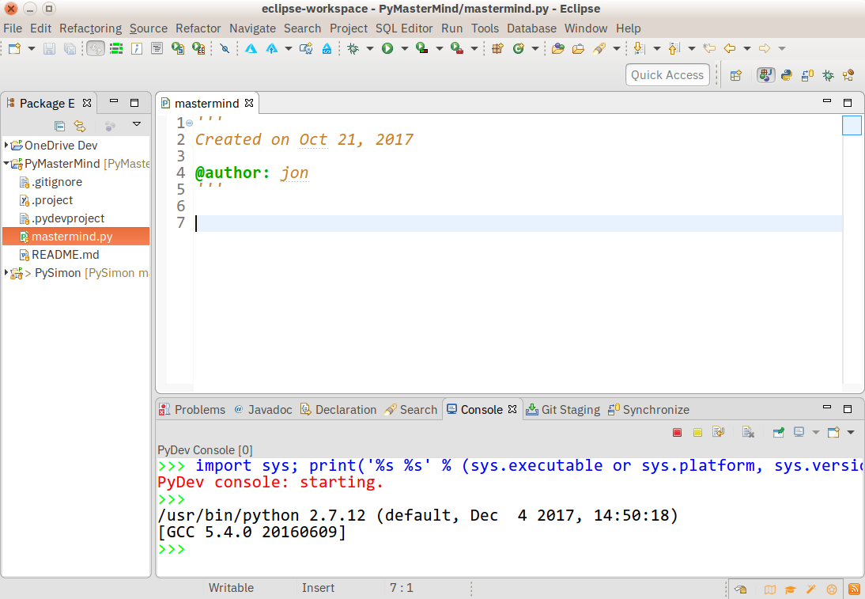
Eclipse + PyDev

Slide 22
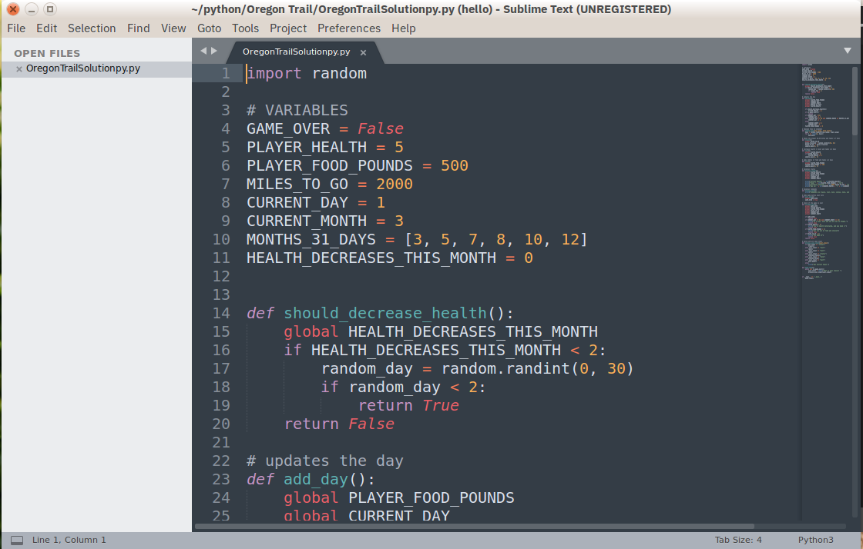
Sublime

Slide 23
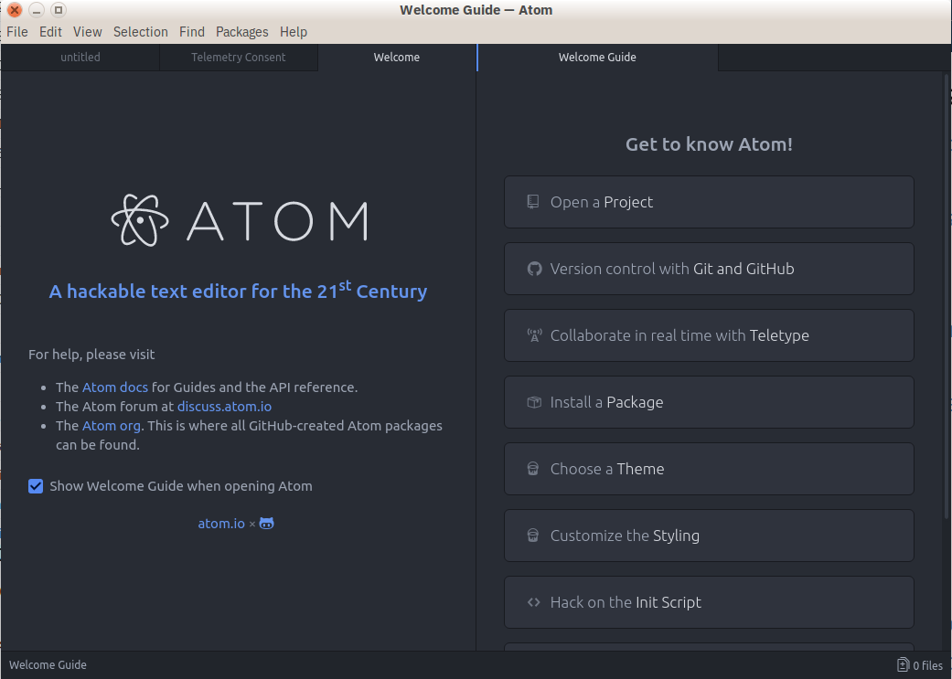
Atom

Slide 24
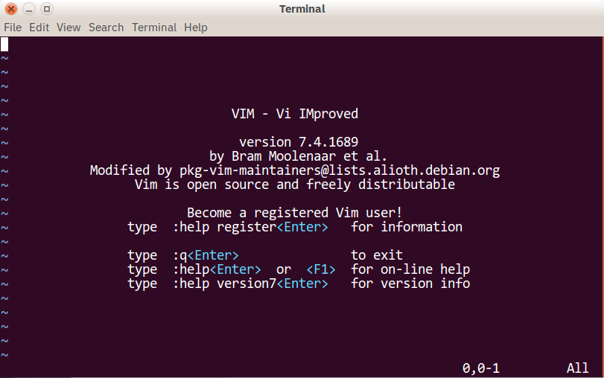
Vim

Slide 25
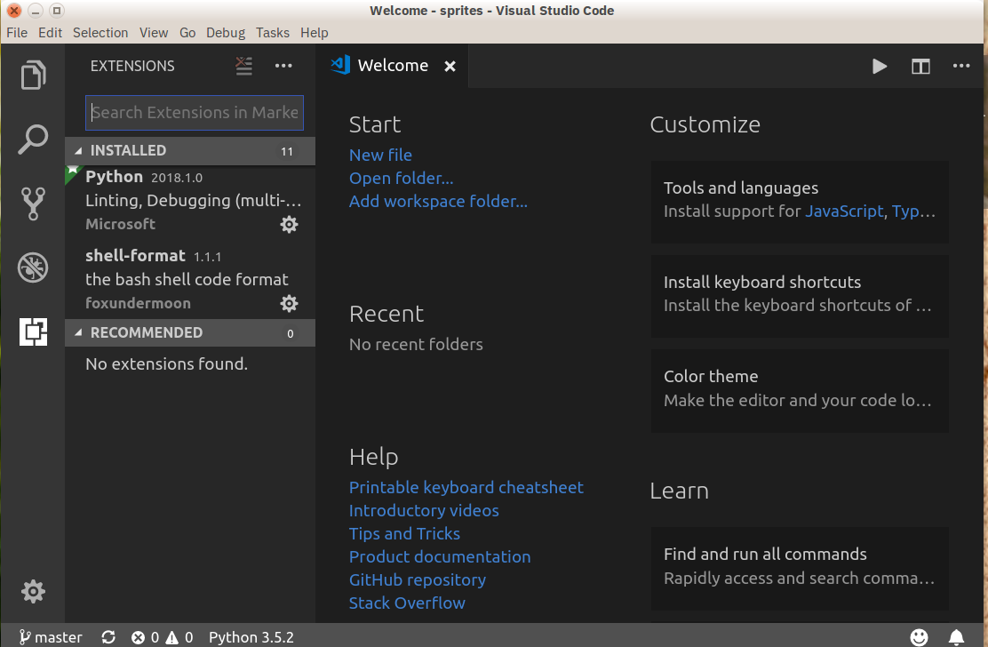
Visual Studio

Slide 26
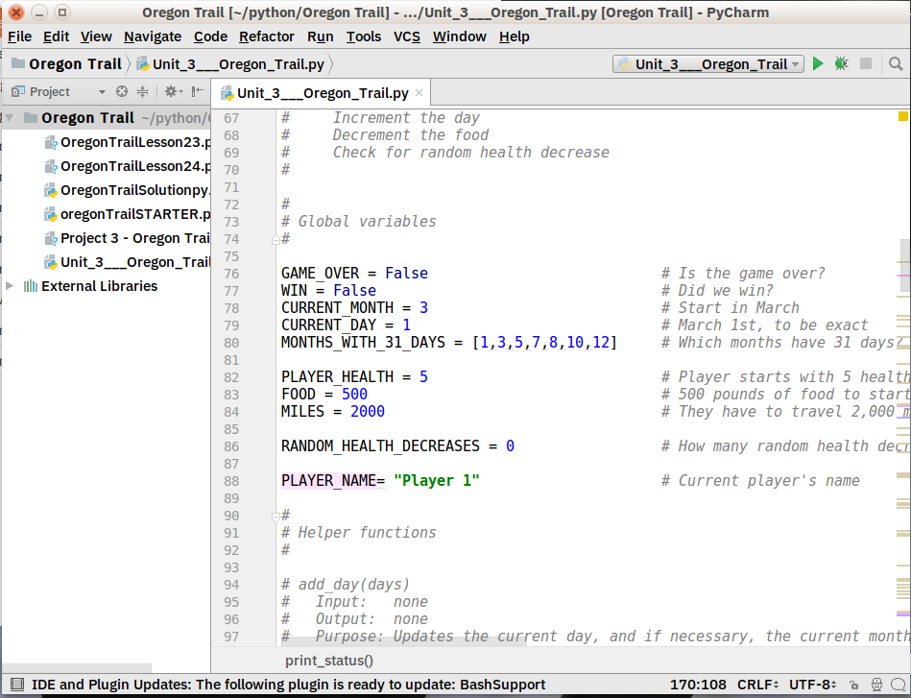
PyCharm
Notes:
Full-feature and dedicated
Available in professional version

Slide 27
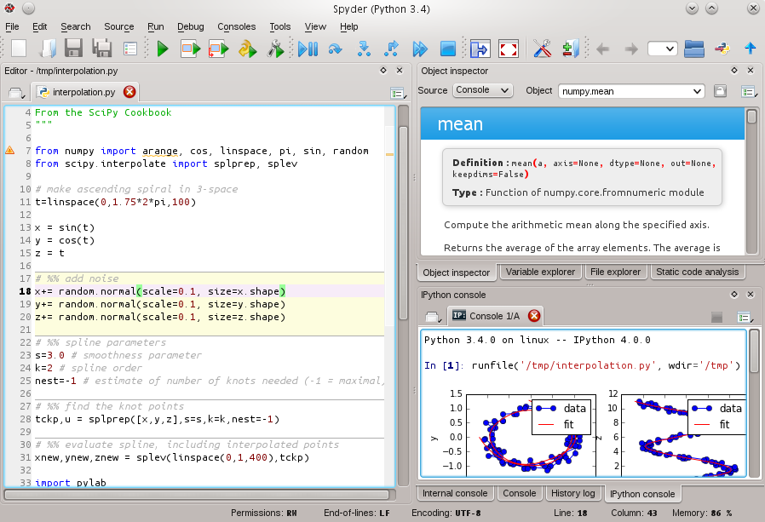
Spyder

Slide 28
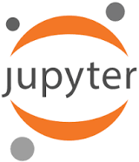
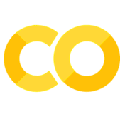
Jupyter Notebook
Web application.
Allows to create docs that contain live Python code.
Ideal to present and share your work
Lecture/Laboratory examples
Works with Google’s Colaboratory
Workshop example

Slide 29
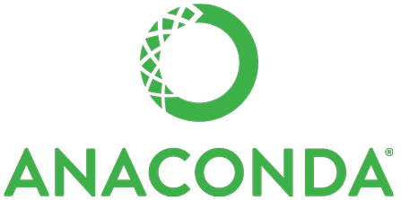
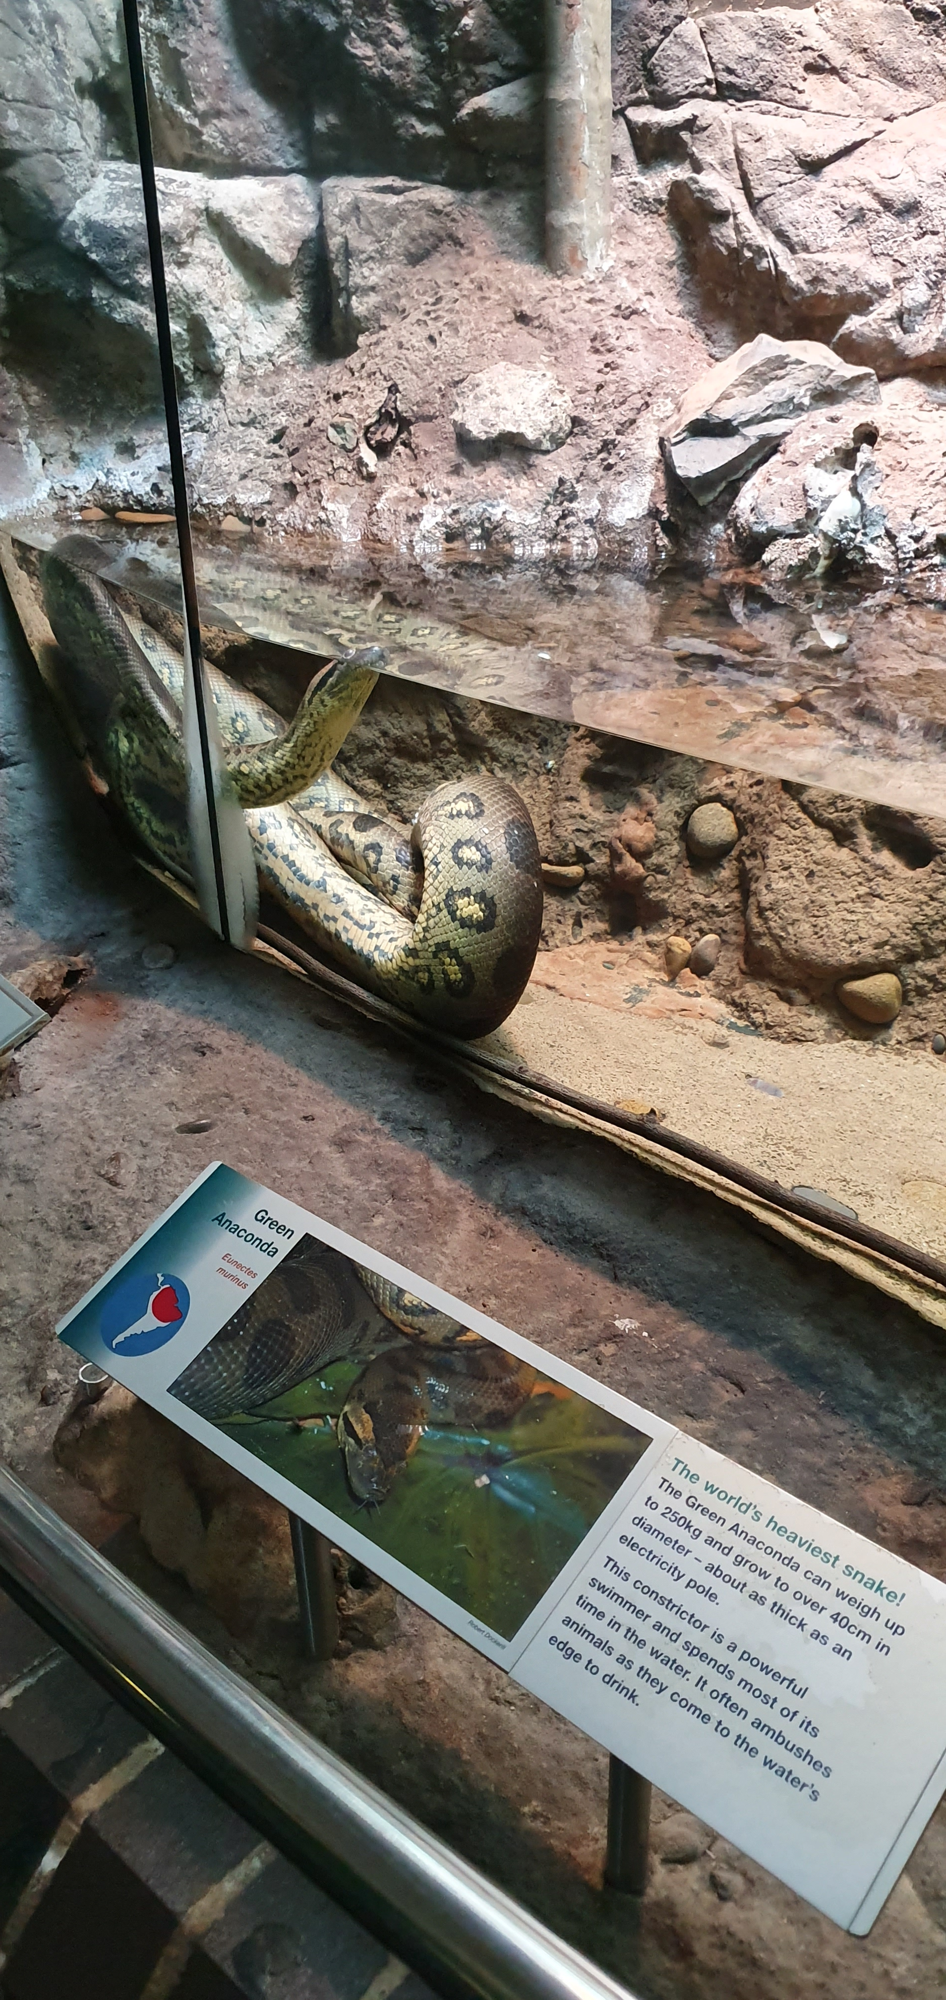
A suite of tools.
Addresses all of the issues we’ve seen.
Allows us to:
control Python versions.
manage packages or libraries on a per project basis.
create virtual environments.
run our Python code.
Default installation includes Jupyter Notebooks:
create and execute code in the browser.
create annotation in Markdown.
all of which you can share.
It even includes R!
Notes:
Anaconda is a suite of tools which we can download and install and use to address all of these issues. If the installation size is too much, you can install Miniconda.
Anaconda allows us to control which version of Python we are using, and manage Python packages or libraries on a per project basis, avoiding conflicts
We can create virtual environments.
The default installation also includes Jupyter Notebooks which allow us to create and execute code _in the browser_ as well as to create annotation in Markdown, all of which you can share.

Slide 30
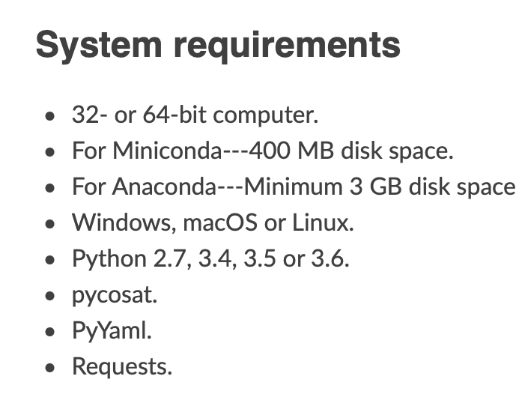
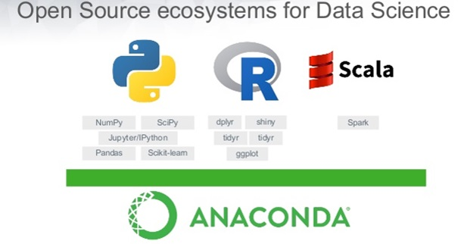
Installing Anaconda
Download and install Anaconda from https://www.anaconda.com/distribution
If that disk space is an issue, download Miniconda! https://docs.conda.io/projects/conda/en/latest/user-guide/install/
Notes:
You can install Anaconda from https://www.anaconda.com/distribution
You can check space requirements and, if that is an issue, download the much smaller Miniconda here
https://docs.conda.io/projects/conda/en/latest/user-guide/install/
This will install the core of the Anaconda system.
Once you have Miniconda installed to add Jupyter Notebooks, in the Terminal run
>> conda install jupyter

Slide 31
Running Anaconda
Let’s run Anaconda Navigator

Slide 32
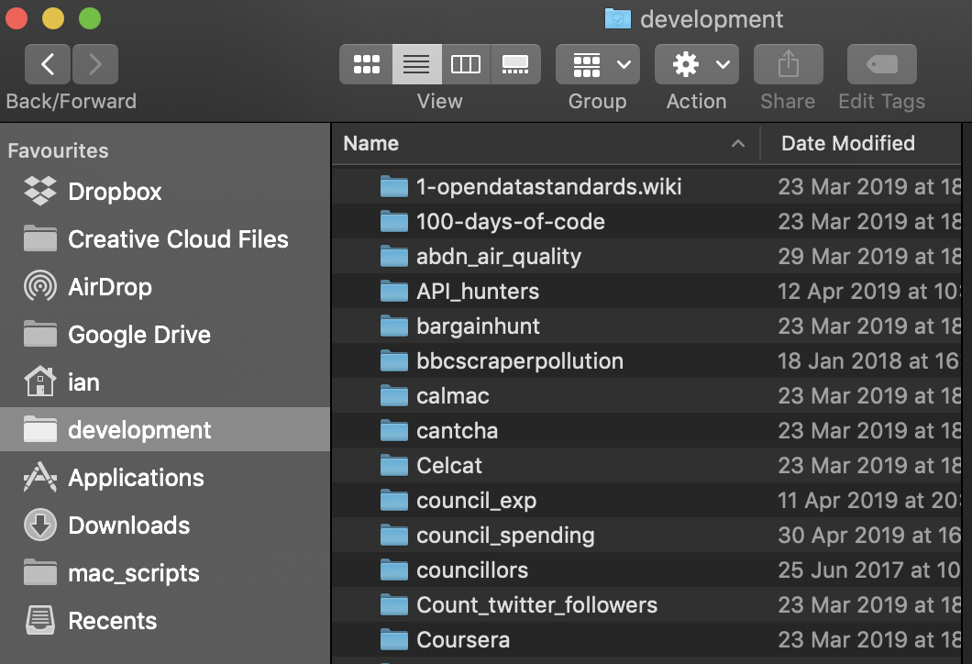
Good practice
Notes:
I have some suggested good practice.
Have a home directory for your projects. Always work in there, creating a new directory for each project.

Slide 33
Good practice
Have a home directory for your projects. Always work in there, creating a new directory for each project.
Get used to the Terminal / bash shell. Learn the basic commands.
pwd, cd, cp, mv, mkdir, ls, etc.*
For every project in which you are using Python and library packages, create a directory and a matching virtual environment.
When working on that project:
move into the project directory
activate the virtual environment
run Jupyter Notebooks (if you are using that).
See this article (Unix, Mac) or this (Win)
Notes:
Get used to the Terminal / bash shell. Learn the basic commands.
For every project in which you are using Python and library packages, create a directory and a matching virtual environment. When working on that project
- move into the project directory
- activate the virtual environment
run Jupyter Notebooks (if you are using that)
By keeping the names the same you can ensure that your project has the libraries it needs installed
I will demonstrate this in a moment

Slide 34
Questions?
c.moreno-garcia@rgu.ac.uk
@CarlosFMorenoG

